Slide 1
Gemma, Python and Wearables
Steve Case & Sana Sarfraz

Slide 2
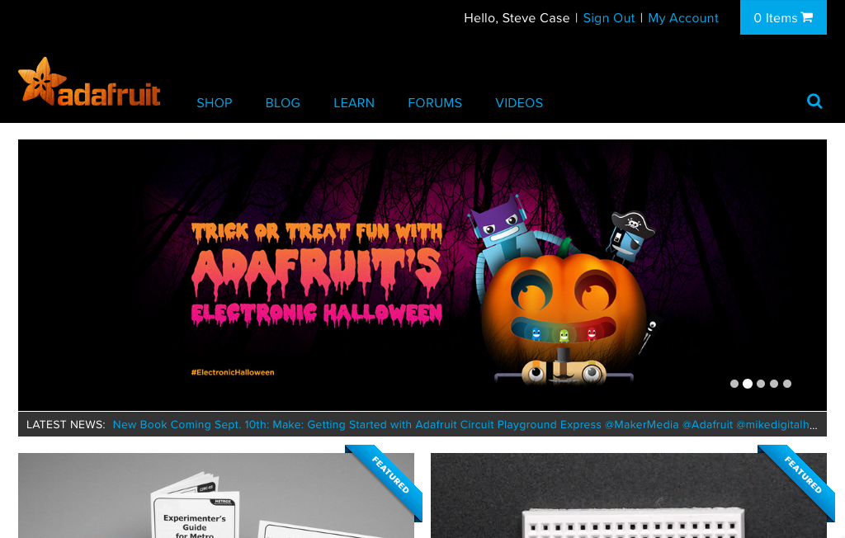
Adafruit Industries

Slide 3

Limor Fried - Lady Ada

Slide 4
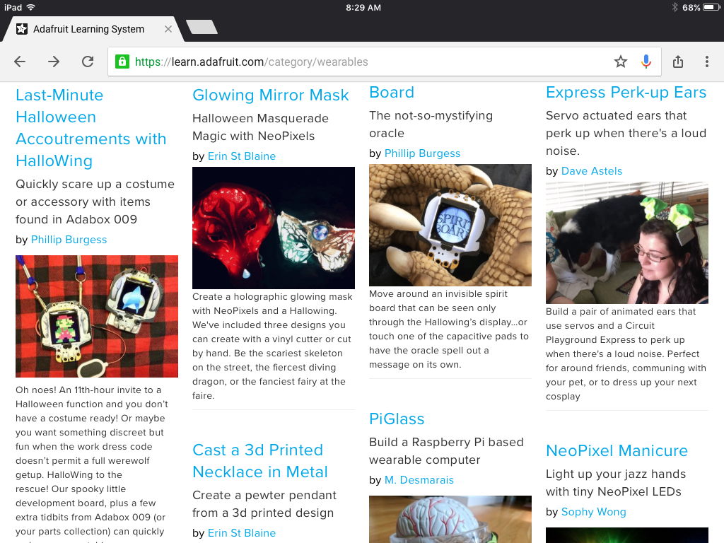
Adafruit Industries

Slide 5
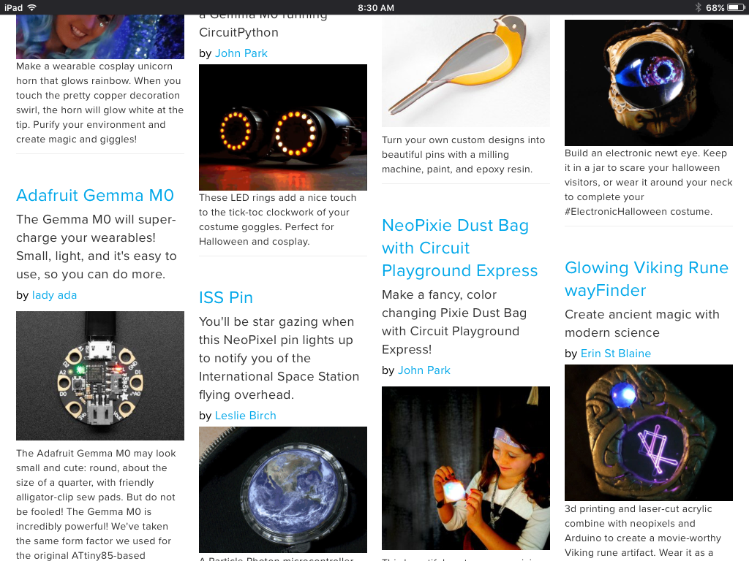
Wearables Projects

Slide 6
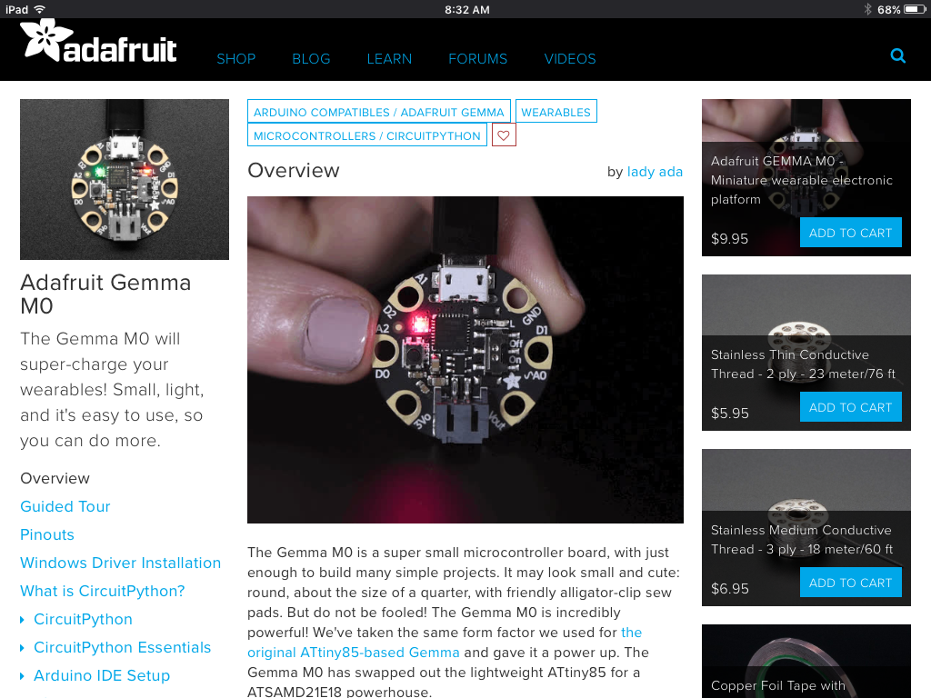
Gemma M0 Development Board

Slide 7
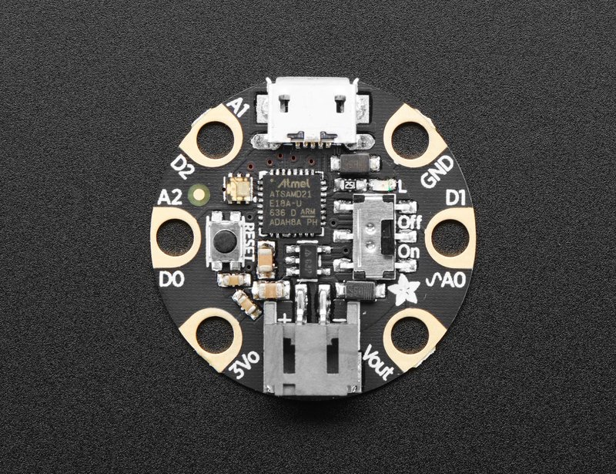
Gemma M0 Development Board

Slide 8
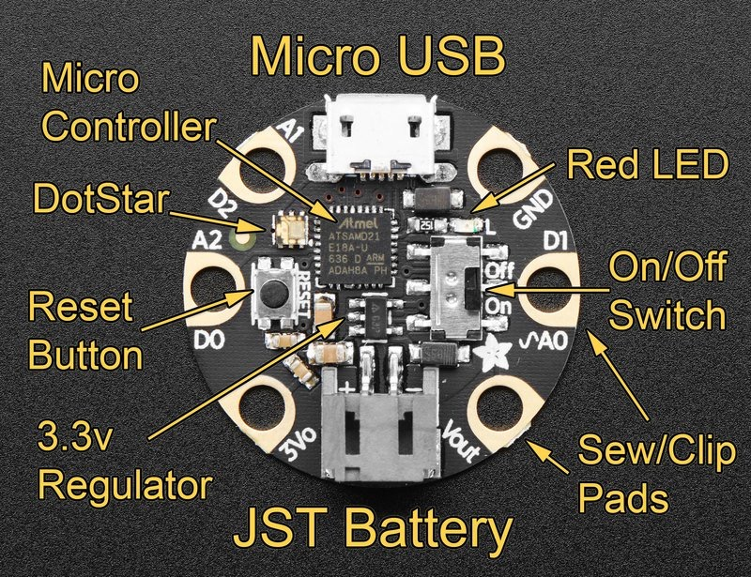
Gemma M0 Development Board

Slide 9

Gemma And CircuitPython

Slide 10

Gemma And REPL
The REPL acts as a monitor and gives feedback on program operation.
Print statements from your program also show up in the monitor screen. (REPL)
….010101010100111011101101
010101010100111011101101….

Slide 11
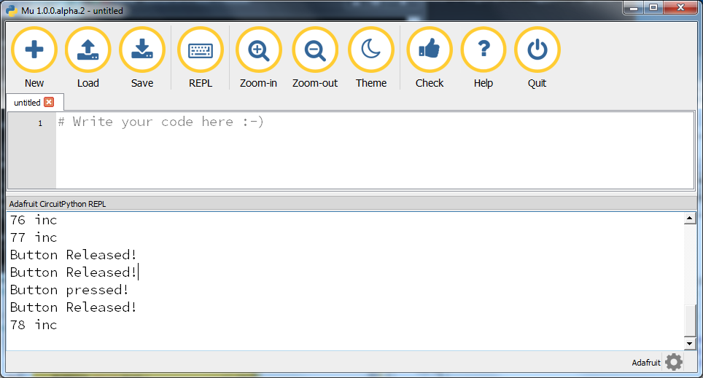
Mu Editor
Program area
REPL area

Slide 12
while_loop.py
# Bring in the libraries that you need
import board
from digitalio import DigitalInOut, Direction, Pull
import time
# Built in red LED is on pin D13 and is internal to the Gemma
led = DigitalInOut(board.D13) # setup external led
led.direction = Direction.OUTPUT # set IO pin as output
i = 1
while i < 5 : # execute loop 5 times
led.value = 1
time.sleep(.5)
led.value = 0
time.sleep(.5)
i = i + 1
print ("Done with 5")

Slide 13
Anatomy of Circuitpython programs
# Bring in the libraries that you need
import board
from digitalio import DigitalInOut, Direction, Pull
import time
# Built in red LED is on pin D13 and is internal to the Gemma
led = DigitalInOut(board.D13) # setup external led
led.direction = Direction.OUTPUT # set IO pin as output
i = 1
while i < 5 : # execute loop 5 times
led.value = 1
time.sleep(.5)
led.value = 0
time.sleep(.5)
i = i + 1
print ("Done with 5")
Libraries
Initialization
Running program

Slide 14
Python Basics - Variables
>>> i = 1
>>> print(i)
1
>>> j = 2.
>>> print(j)
2.0
>>> name = “Coco”
>>> print(name)
Coco

Slide 15
for_loop.py
# Bring in the libraries that you need
import board
from digitalio import DigitalInOut, Direction, Pull
import time
# Built in red LED is on pin D13 and is internal to the Gemma
led = DigitalInOut(board.D13) # setup external led
led.direction = Direction.OUTPUT # set IO pin as output
# Execute loop 5 times
for i in range (5):
led.value = 1
time.sleep(.5)
led.value = 0
time.sleep(.5)
print ("Done with 5")

Slide 16
ex_led_blink.py
# Bring in the libraries that you need
import board
from digitalio import DigitalInOut, Direction
import time
# Built in red LED is on pin D13 and is internal to the Gemma
led = DigitalInOut(board.D13) # setup external led
led.direction = Direction.OUTPUT # set IO pin as output
exled = DigitalInOut(board.D1) # setup external led
exled.direction = Direction.OUTPUT # and the IO pin as output
while True: # execute loop forever
led.value = 1
exled.value = 0
time.sleep(4)
led.value = 0
exled.value = 1
time.sleep(4)

Slide 17
ex_led_blink2.py
# Bring in the libraries that you need
import board
from digitalio import DigitalInOut, Direction
import time
# Built in red LED is on pin D13 and is internal to the Gemma
led = DigitalInOut(board.D13) # setup external led
led.direction = Direction.OUTPUT # set IO pin as output
exled = DigitalInOut(board.D1) # setup external led
exled.direction = Direction.OUTPUT # and the IO pin as output
ON = 1
OFF = 0
while True: # execute loop forever
led.value = OFF
exled.value = OFF
time.sleep(4)
led.value = ON
exled.value = ON
time.sleep(4)

Slide 18
dot_star0.py
import adafruit_dotstar
import time
from board import *
RED = 0x100000
with adafruit_dotstar.DotStar(APA102_SCK, APA102_MOSI, 1) as pixels:
pixels[0] = RED
time.sleep(2)

Slide 19
dot_star1.py
# Blink random colors on the DotStar
# Bring in the libraries that you need
import time
import random
import board
import adafruit_dotstar as dotstar
# One pixel connected internally on a GEMMA M0
dots = dotstar.DotStar(board.APA102_SCK, board.APA102_MOSI, 1, brightness=0.2)
# This is a function that we will use again and again
# Generate a random color 0 -> 224
def random_color():
return random.randrange(0, 7) * 32
n_dots = len(dots)
while True:
#fill each dot with a random color
for dot in range(n_dots):
dots[dot] = (random_color(), random_color(), random_color())
# show all dots in strip
dots.show()
time.sleep(.25)

Slide 20
wink.py
# Use both of the LED's on the Gemma to wink together
# Get the libraries that you need
import adafruit_dotstar
import time
from board import *
from digitalio import DigitalInOut, Direction
# Built in red LED
led = DigitalInOut(D13)
led.direction = Direction.OUTPUT # set IO pin as output
RED = 0x1F0000
OFF = 0x000000
with adafruit_dotstar.DotStar(APA102_SCK, APA102_MOSI, 1) as pixels:
while True:
pixels[0] = RED
led.value = 1
time.sleep(2)
pixels[0] = OFF
led.value = 0
time.sleep(2)

Slide 21
wink2.py
# Use both of the LED's on the Gemma to wink together
. . .
RED = 0x1F0000
OFF = 0x000000
with adafruit_dotstar.DotStar(APA102_SCK, APA102_MOSI, 1) as pixels:
while True:
for i in range (16):
pixels[0] = RED
time.sleep(.1)
pixels[0] = OFF
time.sleep(.1)
for i in range (16):
led.value = 1
time.sleep(.1)
led.value = 0
time.sleep(.1)

Slide 22
Reference material
Adafruit Industries: www.adafruit.com
Gemma M0 learning: www.learn.adafruit.com/adafruit-gemma-m0?view=all
Sparkfun electronics: www.sparkfun.com
Mu-Editor Installation:
https://codewith.mu/en/download
Seminar Slides:
https://docs.google.com/presentation/d/1-rhsECbdl-_QQHVEifSHUANQlVRY3bAzd5QX7KLlMLc/edit?usp=sharing
Python:
https://www.w3schools.com/python/default.asp
https://www.python.org/ (advanced full reference for Python)
https://wiki.python.org/moin/BeginnersGuide (still pretty advanced)
Electronics basics videos
AddOhms Channel:
https://www.youtube.com/watch?v=lYZUXV-v71Y&list=PLRIGIzu0Z7KlfGFD6gd0eMX0ozfJyrQL-
Afrotechmods:
https://www.youtube.com/watch?v=Yo6JI_bzUzo&index=3&list=PLzqS33DOPhJkRn6e9_OTdQwRojO8qlusI

